Slide 2
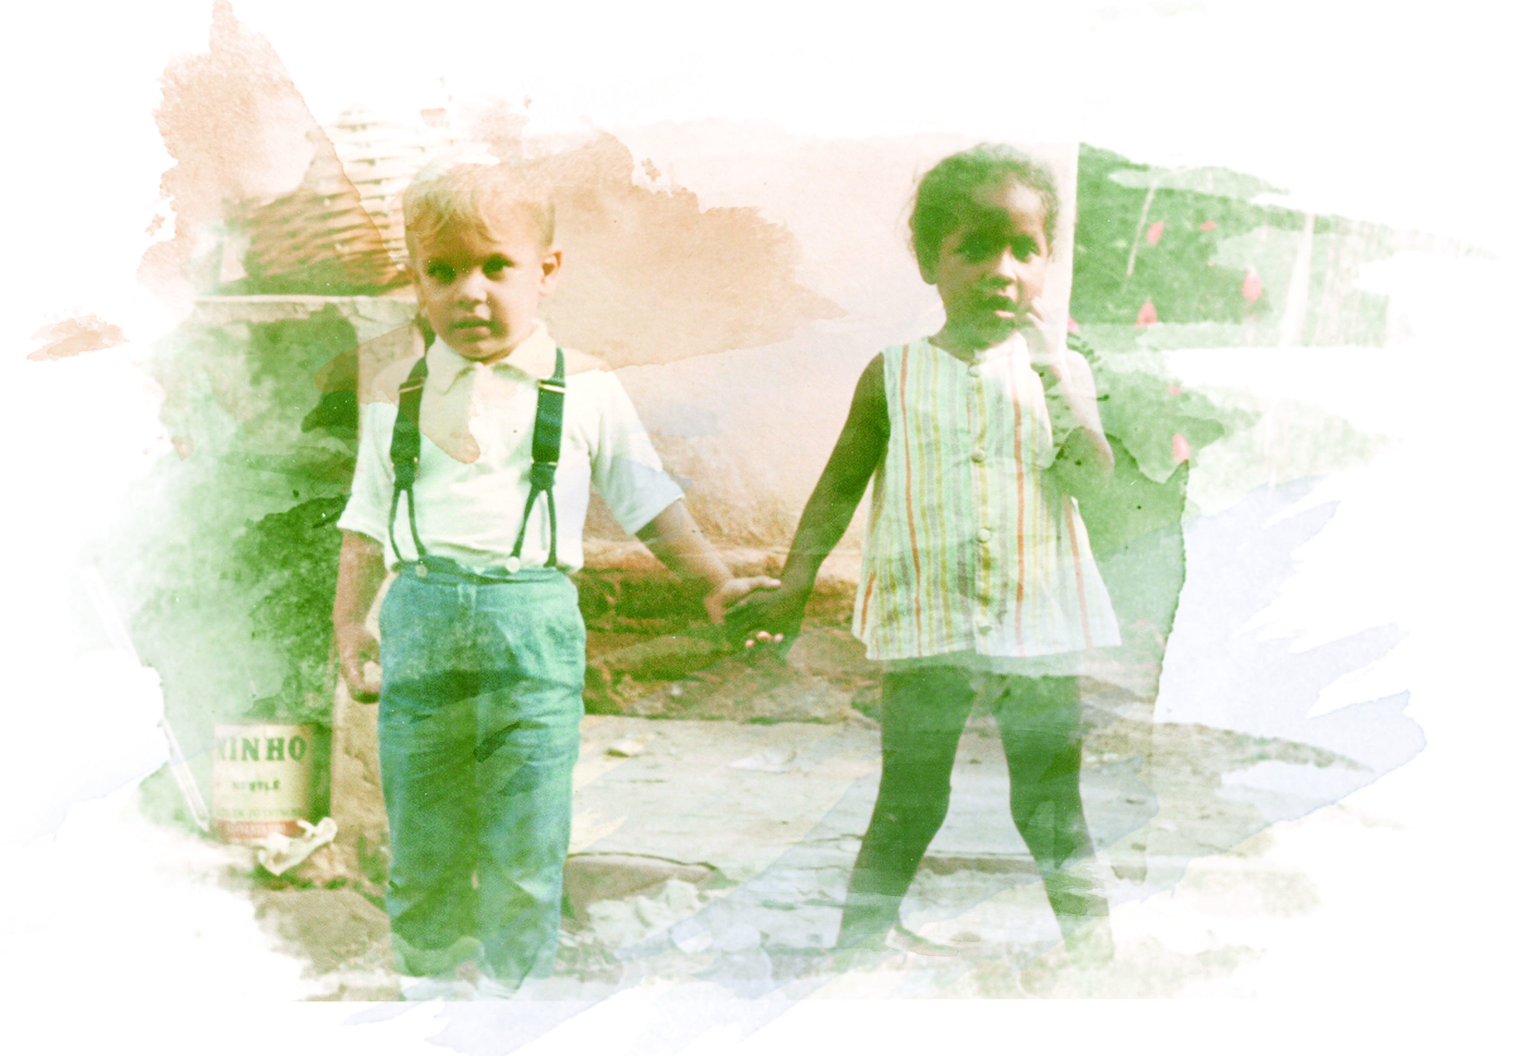
To Serve or Not To Serve?

Slide 3
Ephesians 3:7
⁷ I became a servant of this gospel by the gift of God's grace given me through the working of his power.

Slide 4
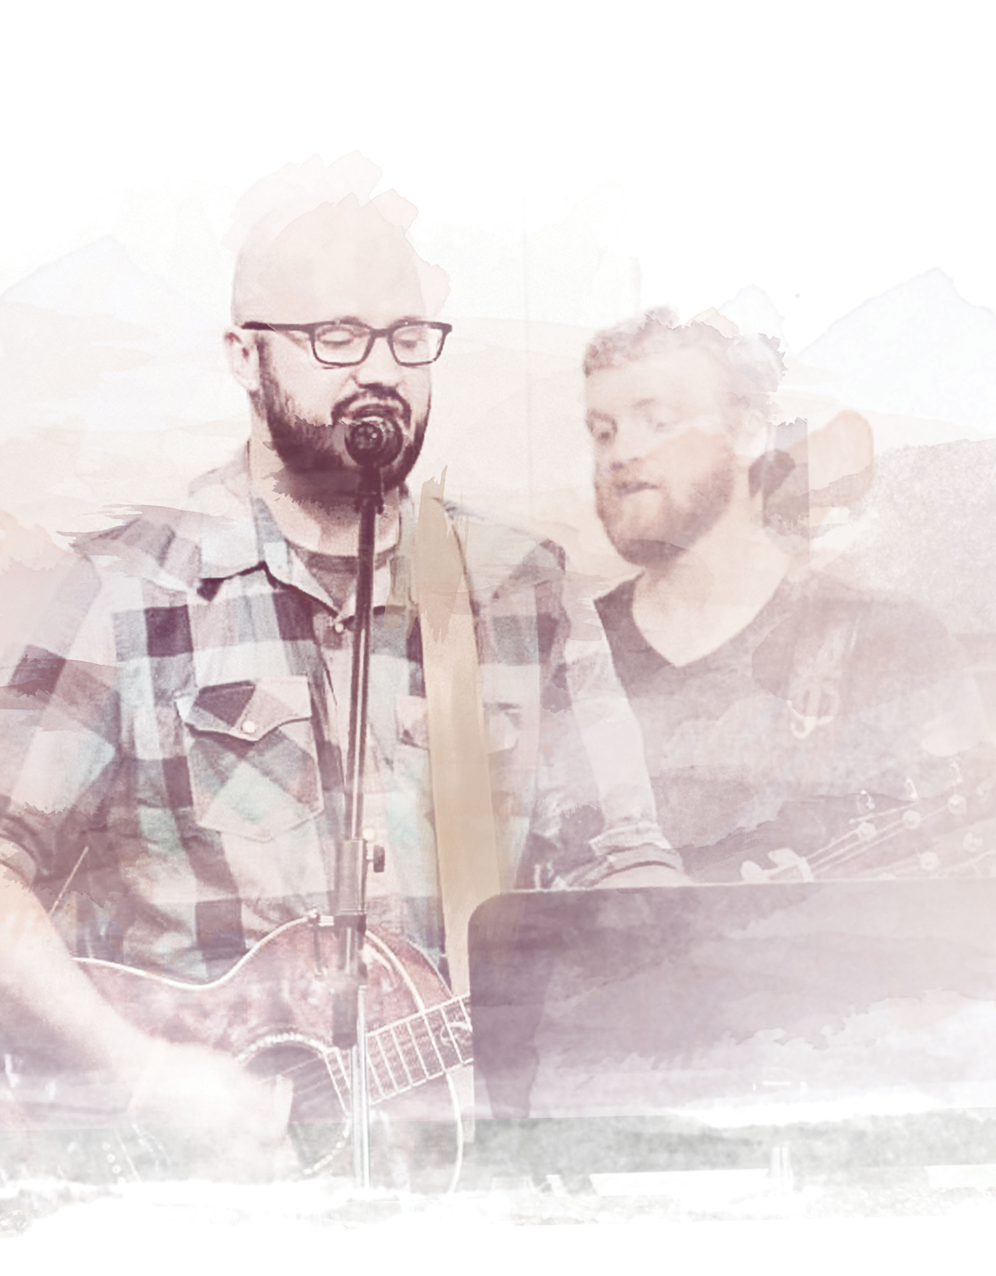
To Be Served

Slide 5
Titus 3:3-8
³ At one time we too were foolish, disobedient, deceived and enslaved by all kinds of passions and pleasures. We lived in malice and envy, being hated and hating one another.

Slide 6
Titus 3:3-8
⁴ But when the kindness and love of God our Savior appeared,

Slide 7
Titus 3:3-8
⁵ he saved us, not because of righteous things we had done, but because of his mercy. He saved us through the washing of rebirth and renewal by the Holy Spirit,

Slide 8
Titus 3:3-8
⁶ whom he poured out on us generously through Jesus Christ our Savior,

Slide 9
Titus 3:3-8
⁷ so that, having been justified by his grace, we might become heirs having the hope of eternal life.

Slide 10
Titus 3:3-8
⁸ This is a trustworthy saying. And I want you to stress these things, so that those who have trusted in God may be careful to devote themselves to doing what is good. These things are excellent and profitable for everyone.

Slide 11
To Serve

Slide 12
Ephesians 3:7
⁷ I became a servant of this gospel by the gift of God's grace given me through the working of his power.

Slide 13
1 John 5:3
³ In fact, this is love for God: to keep his commands. And his commands are not burdensome…

Slide 14
To Serve or Not To Serve?

