Slide 2
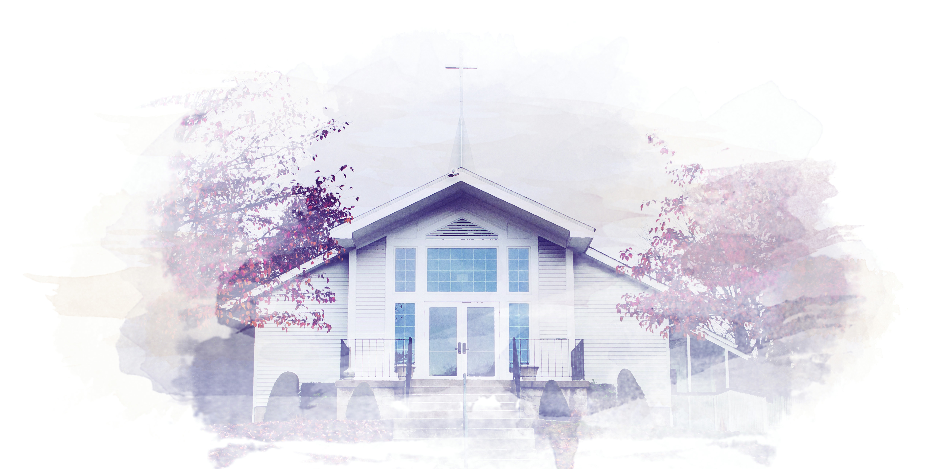
Worship Depends on What you Believe

Slide 3
Psalm 34:1-3
¹ I will praise the Lord at all times. I will constantly speak his praises.

Slide 4
Psalm 34:1-3
² I will boast only in the Lord;
let all who are helpless take heart.

Slide 5
Psalm 34:1-3
³ Come, let us tell of the Lord’s greatness; let us exalt his name together.

Slide 6
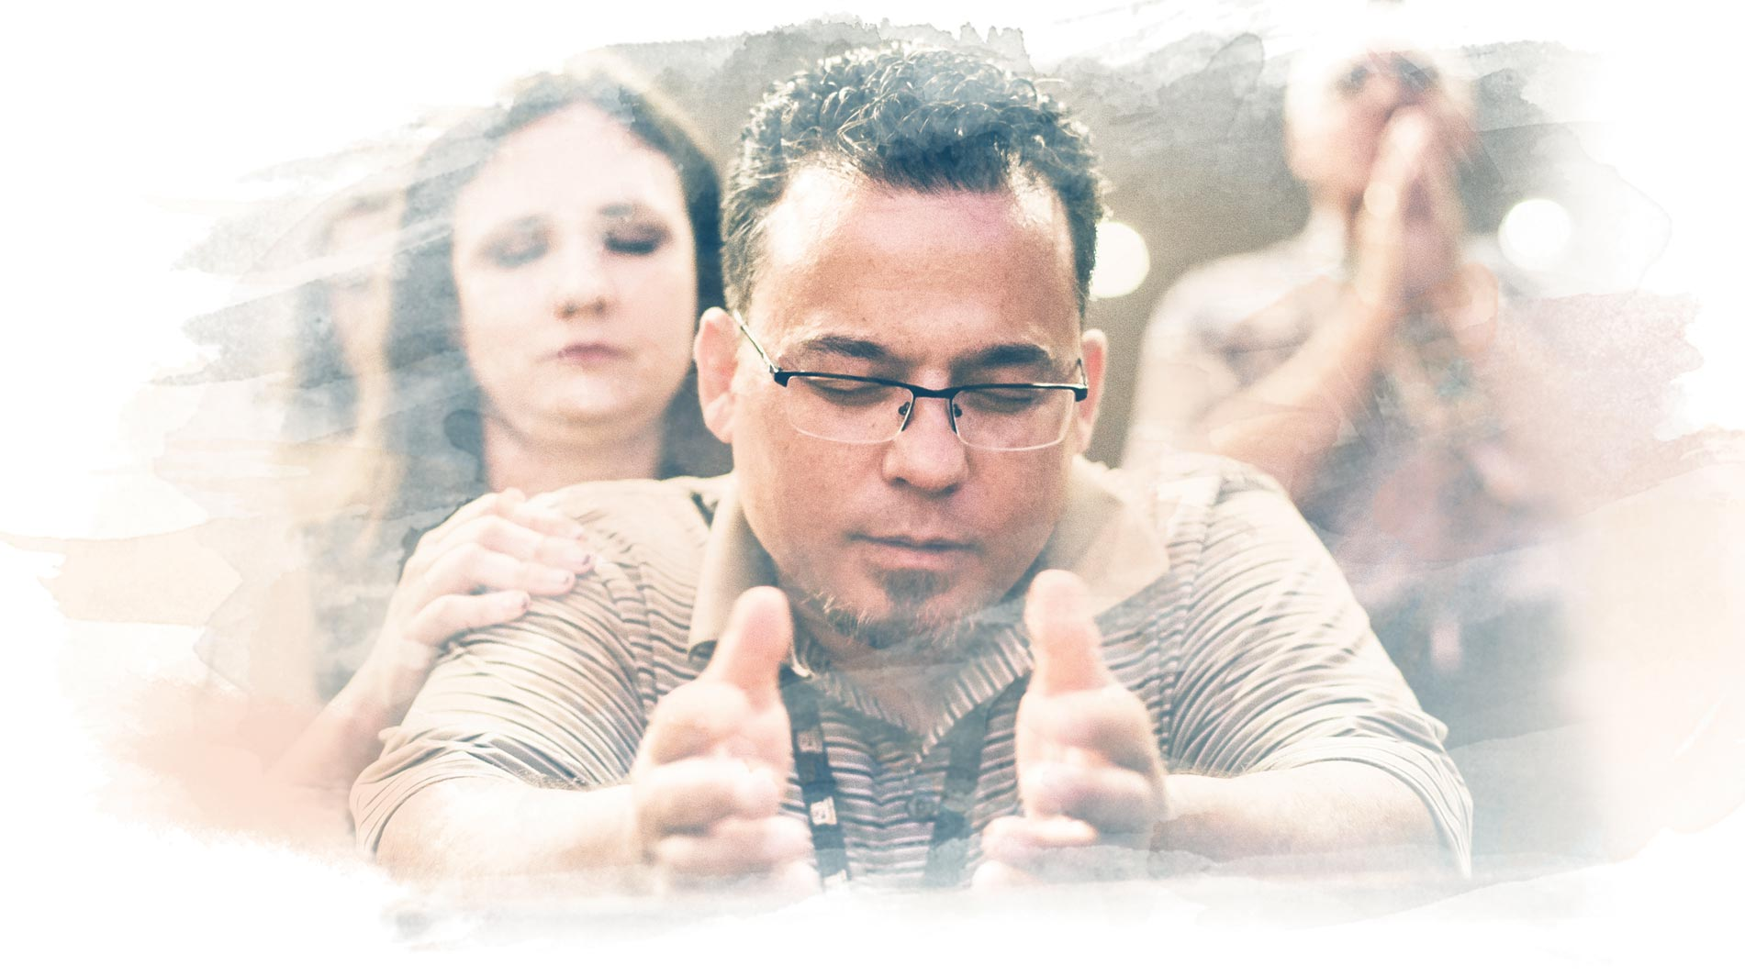
Meaningful Worship

Slide 7
John 4:19-24
¹⁹ “Sir,” the woman said, “you must be a prophet.

Slide 8
John 4:19-24
²⁰ So tell me, why is it that you Jews insist that Jerusalem is the only place of worship, while we Samaritans claim it is here at Mount Gerizim, where our ancestors worshiped?”

Slide 9
John 4:19-24
²¹ Jesus replied, “Believe me, dear woman, the time is coming when it will no longer matter whether you worship the Father on this mountain or in Jerusalem.

Slide 10
John 4:19-24
²² You Samaritans know very little about the one you worship, while we Jews know all about him, for salvation comes through the Jews.

Slide 11
John 4:19-24
²³ But the time is coming—indeed it’s here now—when true worshipers will worship the Father in spirit and in truth. The Father is looking for those who will worship him that way.

Slide 12
John 4:19-24
²⁴ For God is Spirit, so those who worship him must worship in spirit and in truth.”

Slide 13
Meaningful Worship

Slide 14
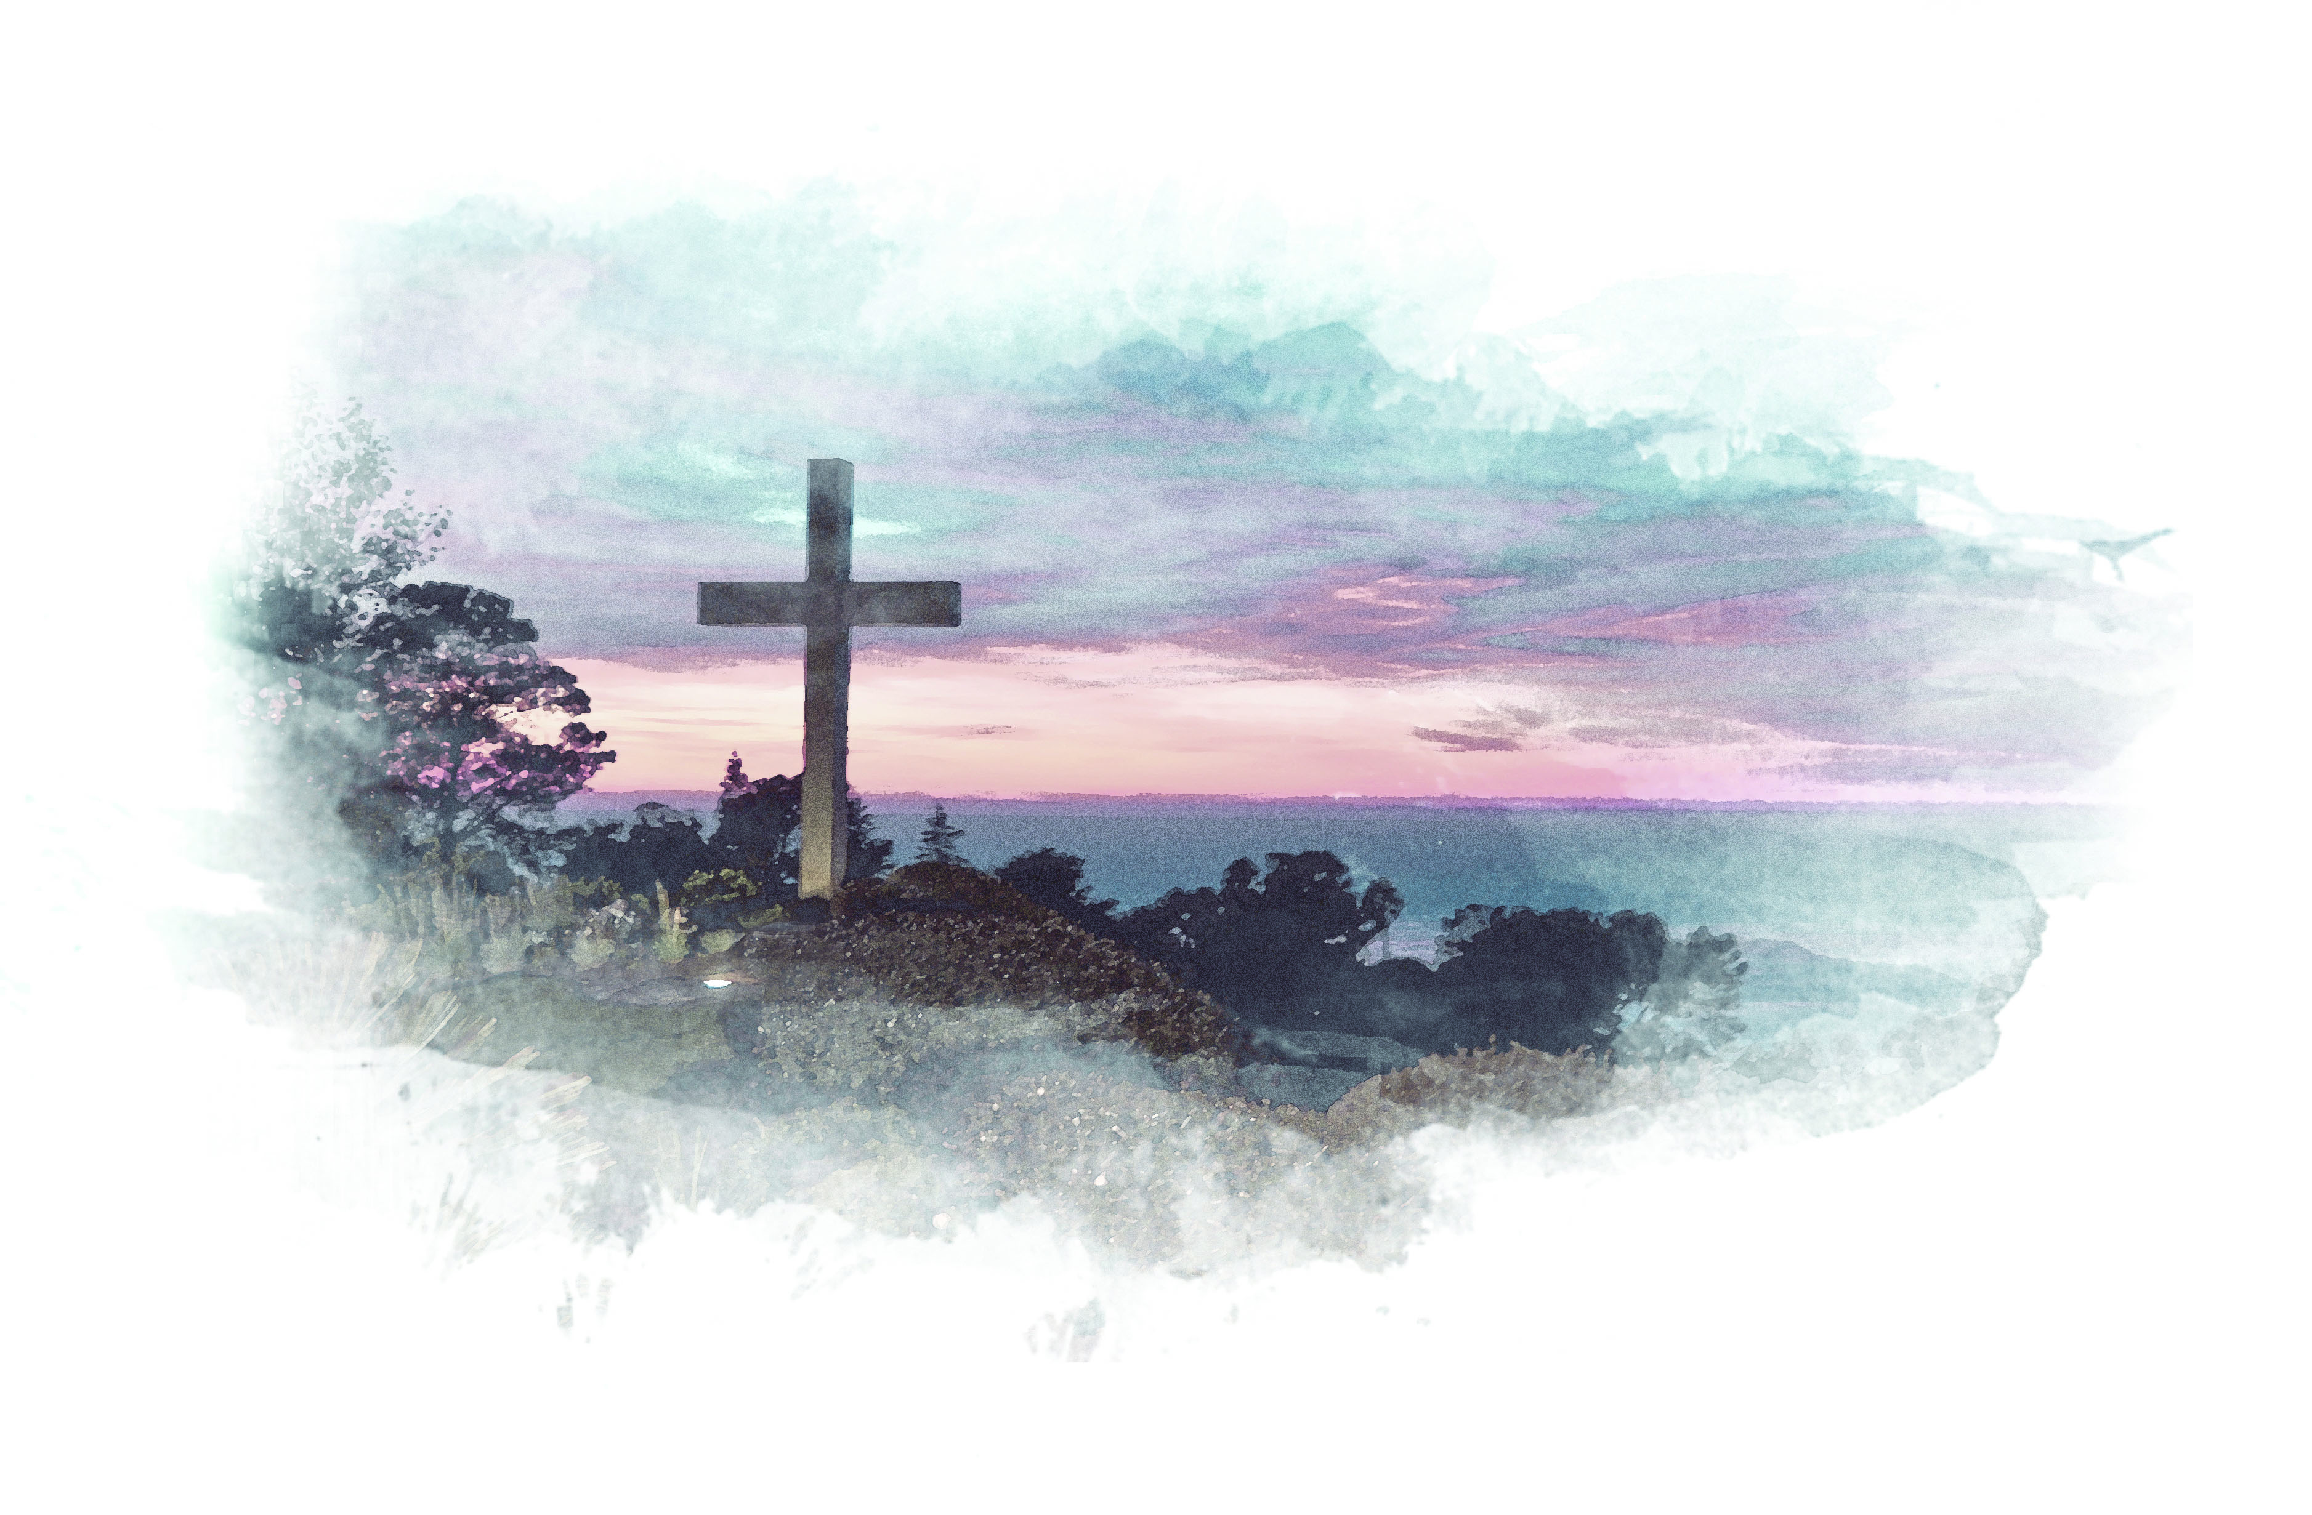
Theological Coherence

Slide 15
1 John 4:15-16
¹⁵ All who confess that Jesus is the Son of God have God living in them, and they live in God.

Slide 16
1 John 4:15-16
¹⁶ We know how much God loves us, and we have put our trust in his love. God is love, and all who live in love live in God, and God lives in them.

Slide 17
Theological Coherence

