Slide 2
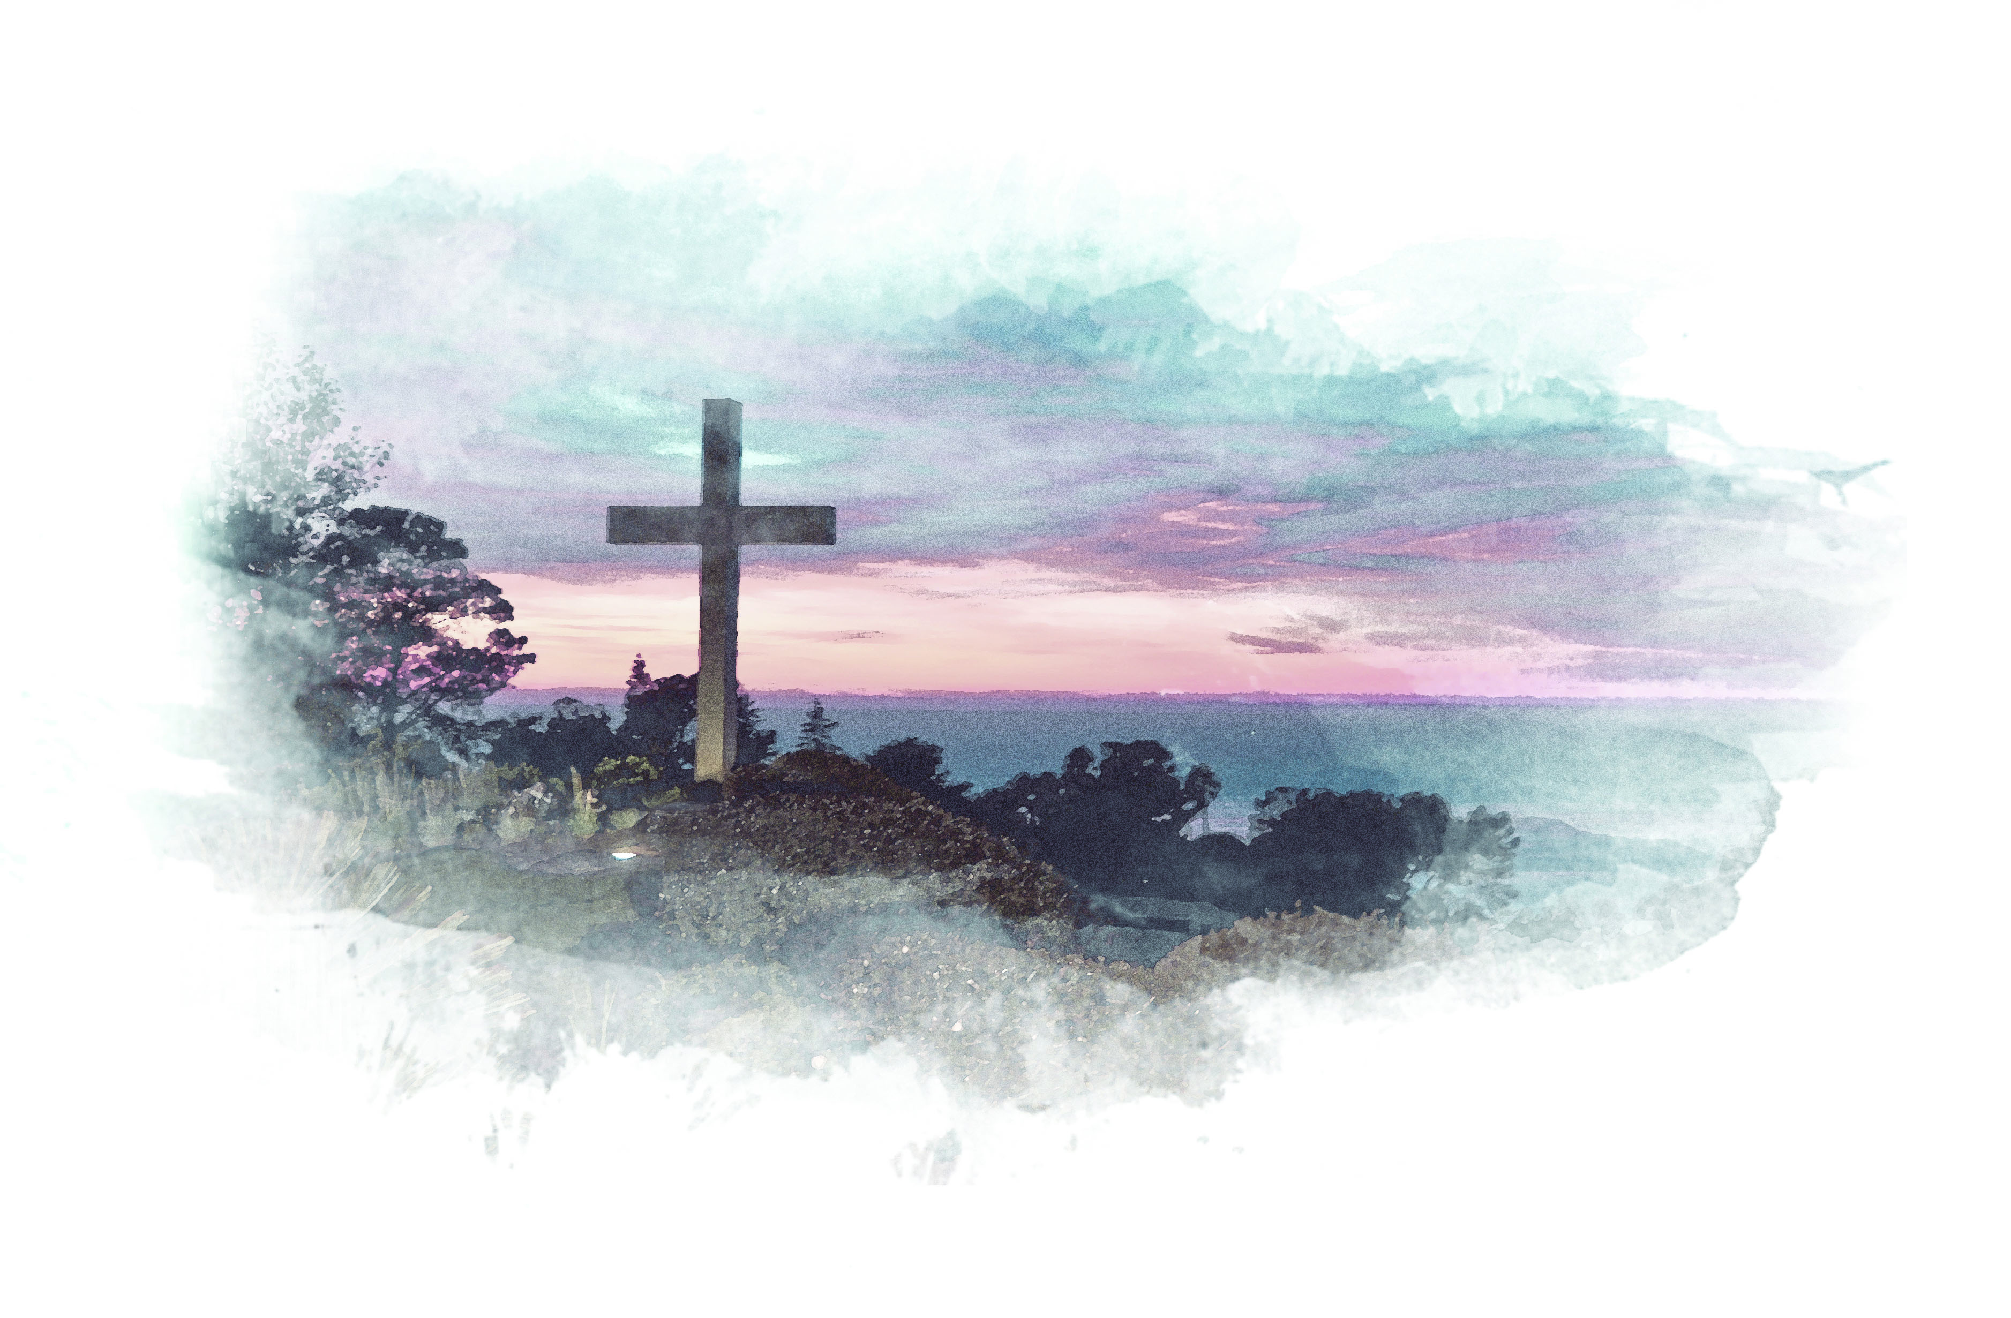
Advancing the Gospel

Slide 3
Church Development

Slide 4
Acts 16:6-10
⁶ Paul and his companions traveled throughout the region of Phrygia and Galatia, having been kept by the Holy Spirit from preaching the word in the province of Asia.

Slide 5
Acts 16:6-10
⁷ When they came to the border of Mysia, they tried to enter Bithynia, but the Spirit of Jesus would not allow them to.

Slide 6
Acts 16:6-10
⁸ So they passed by Mysia and went down to Troas.

Slide 7
Acts 16:6-10
⁹ During the night Paul had a vision of a man of Macedonia standing and begging him, “Come over to Macedonia and help us.”

Slide 8
Acts 16:6-10
¹⁰ After Paul had seen the vision, we got ready at once to leave for Macedonia, concluding that God had called us to preach the gospel to them.

Slide 9
Church Development

Slide 10
Transformational Leadership

Slide 11
Proverbs 29:18
¹⁸ Where there is no vision the people perish…

Slide 12
Habakkuk 2:2
² “Write down the revelation and make it plain on tablets so that a herald may run with it.”

Slide 13
Transformational Leadership

Slide 14
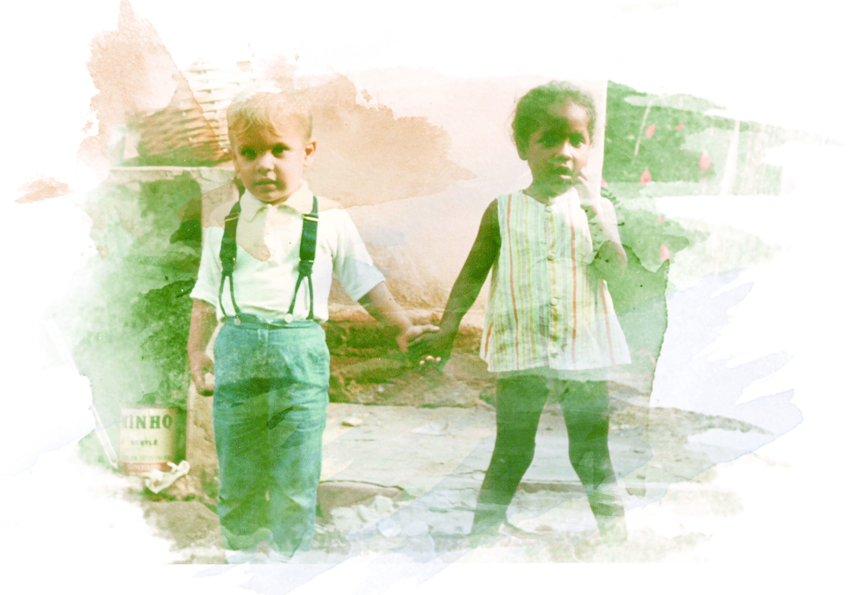
Purposeful Compassion

Slide 15
1 John 3:16-18
¹⁶ This is how we know what love is: Jesus Christ laid down his life for us. And we ought to lay down our lives for our brothers and sisters.

Slide 16
1 John 3:16-18
¹⁷ If anyone has material possessions and sees a brother or sister in need but has no pity on them, how can the love of God be in that person?

Slide 17
1 John 3:16-18
¹⁸ Dear children, let us not love with words or speech but with actions and in truth.

Slide 18
Purposeful Compassion

