Slide 2
Theology in Life

Slide 3
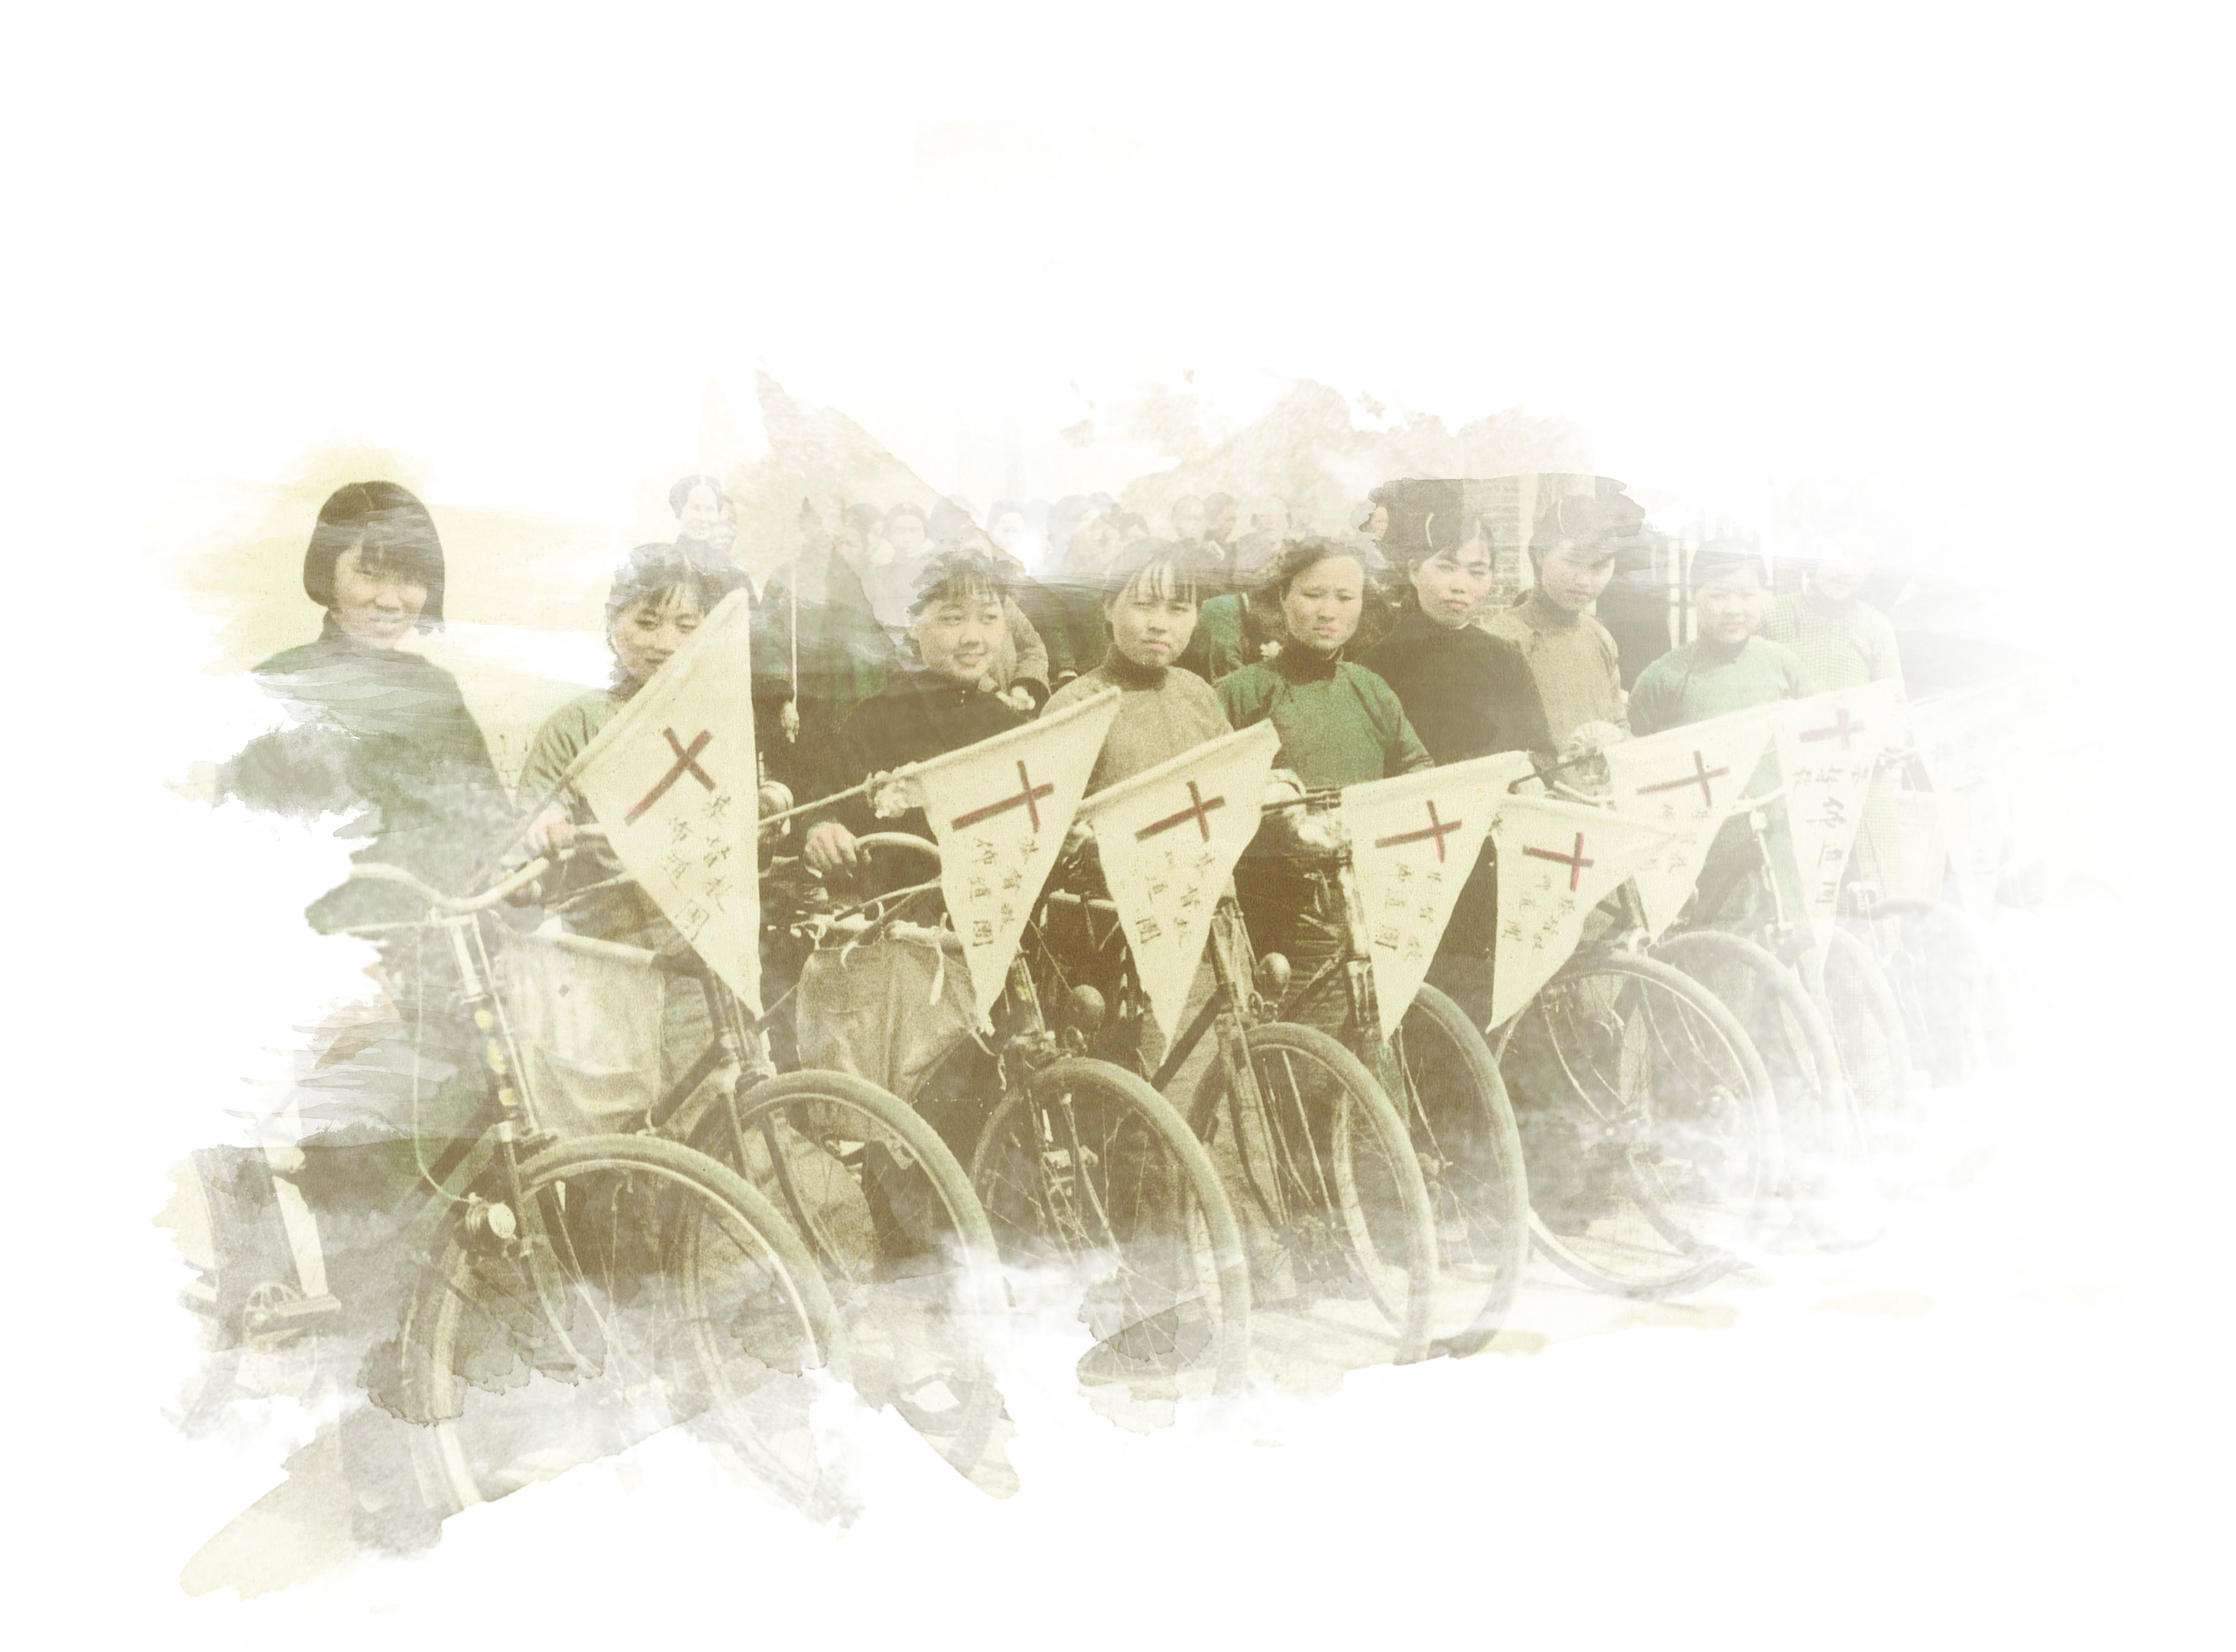
Theology

Slide 4
Romans 5:6
⁶ You see, at just the right time, when we were still powerless, Christ died for the ungodly.

Slide 5
Romans 5:9-11
⁹ Since we have now been justified by his blood, how much more shall we be saved from God’s wrath through him!

Slide 6
Romans 5:9-11
¹⁰ For if, while we were God’s enemies, we were reconciled to him through the death of his Son, how much more, having been reconciled, shall we be saved through his life!

Slide 7
Romans 5:9-11
¹¹ Not only is this so, but we also boast in God through our Lord Jesus Christ, through whom we have now received reconciliation.

Slide 8
Theology

Slide 9
Life

Slide 10
1 John 4:4
⁴ “…the one who is in you is greater than the one who is in the world.”

Slide 11
Life

