Slide 2
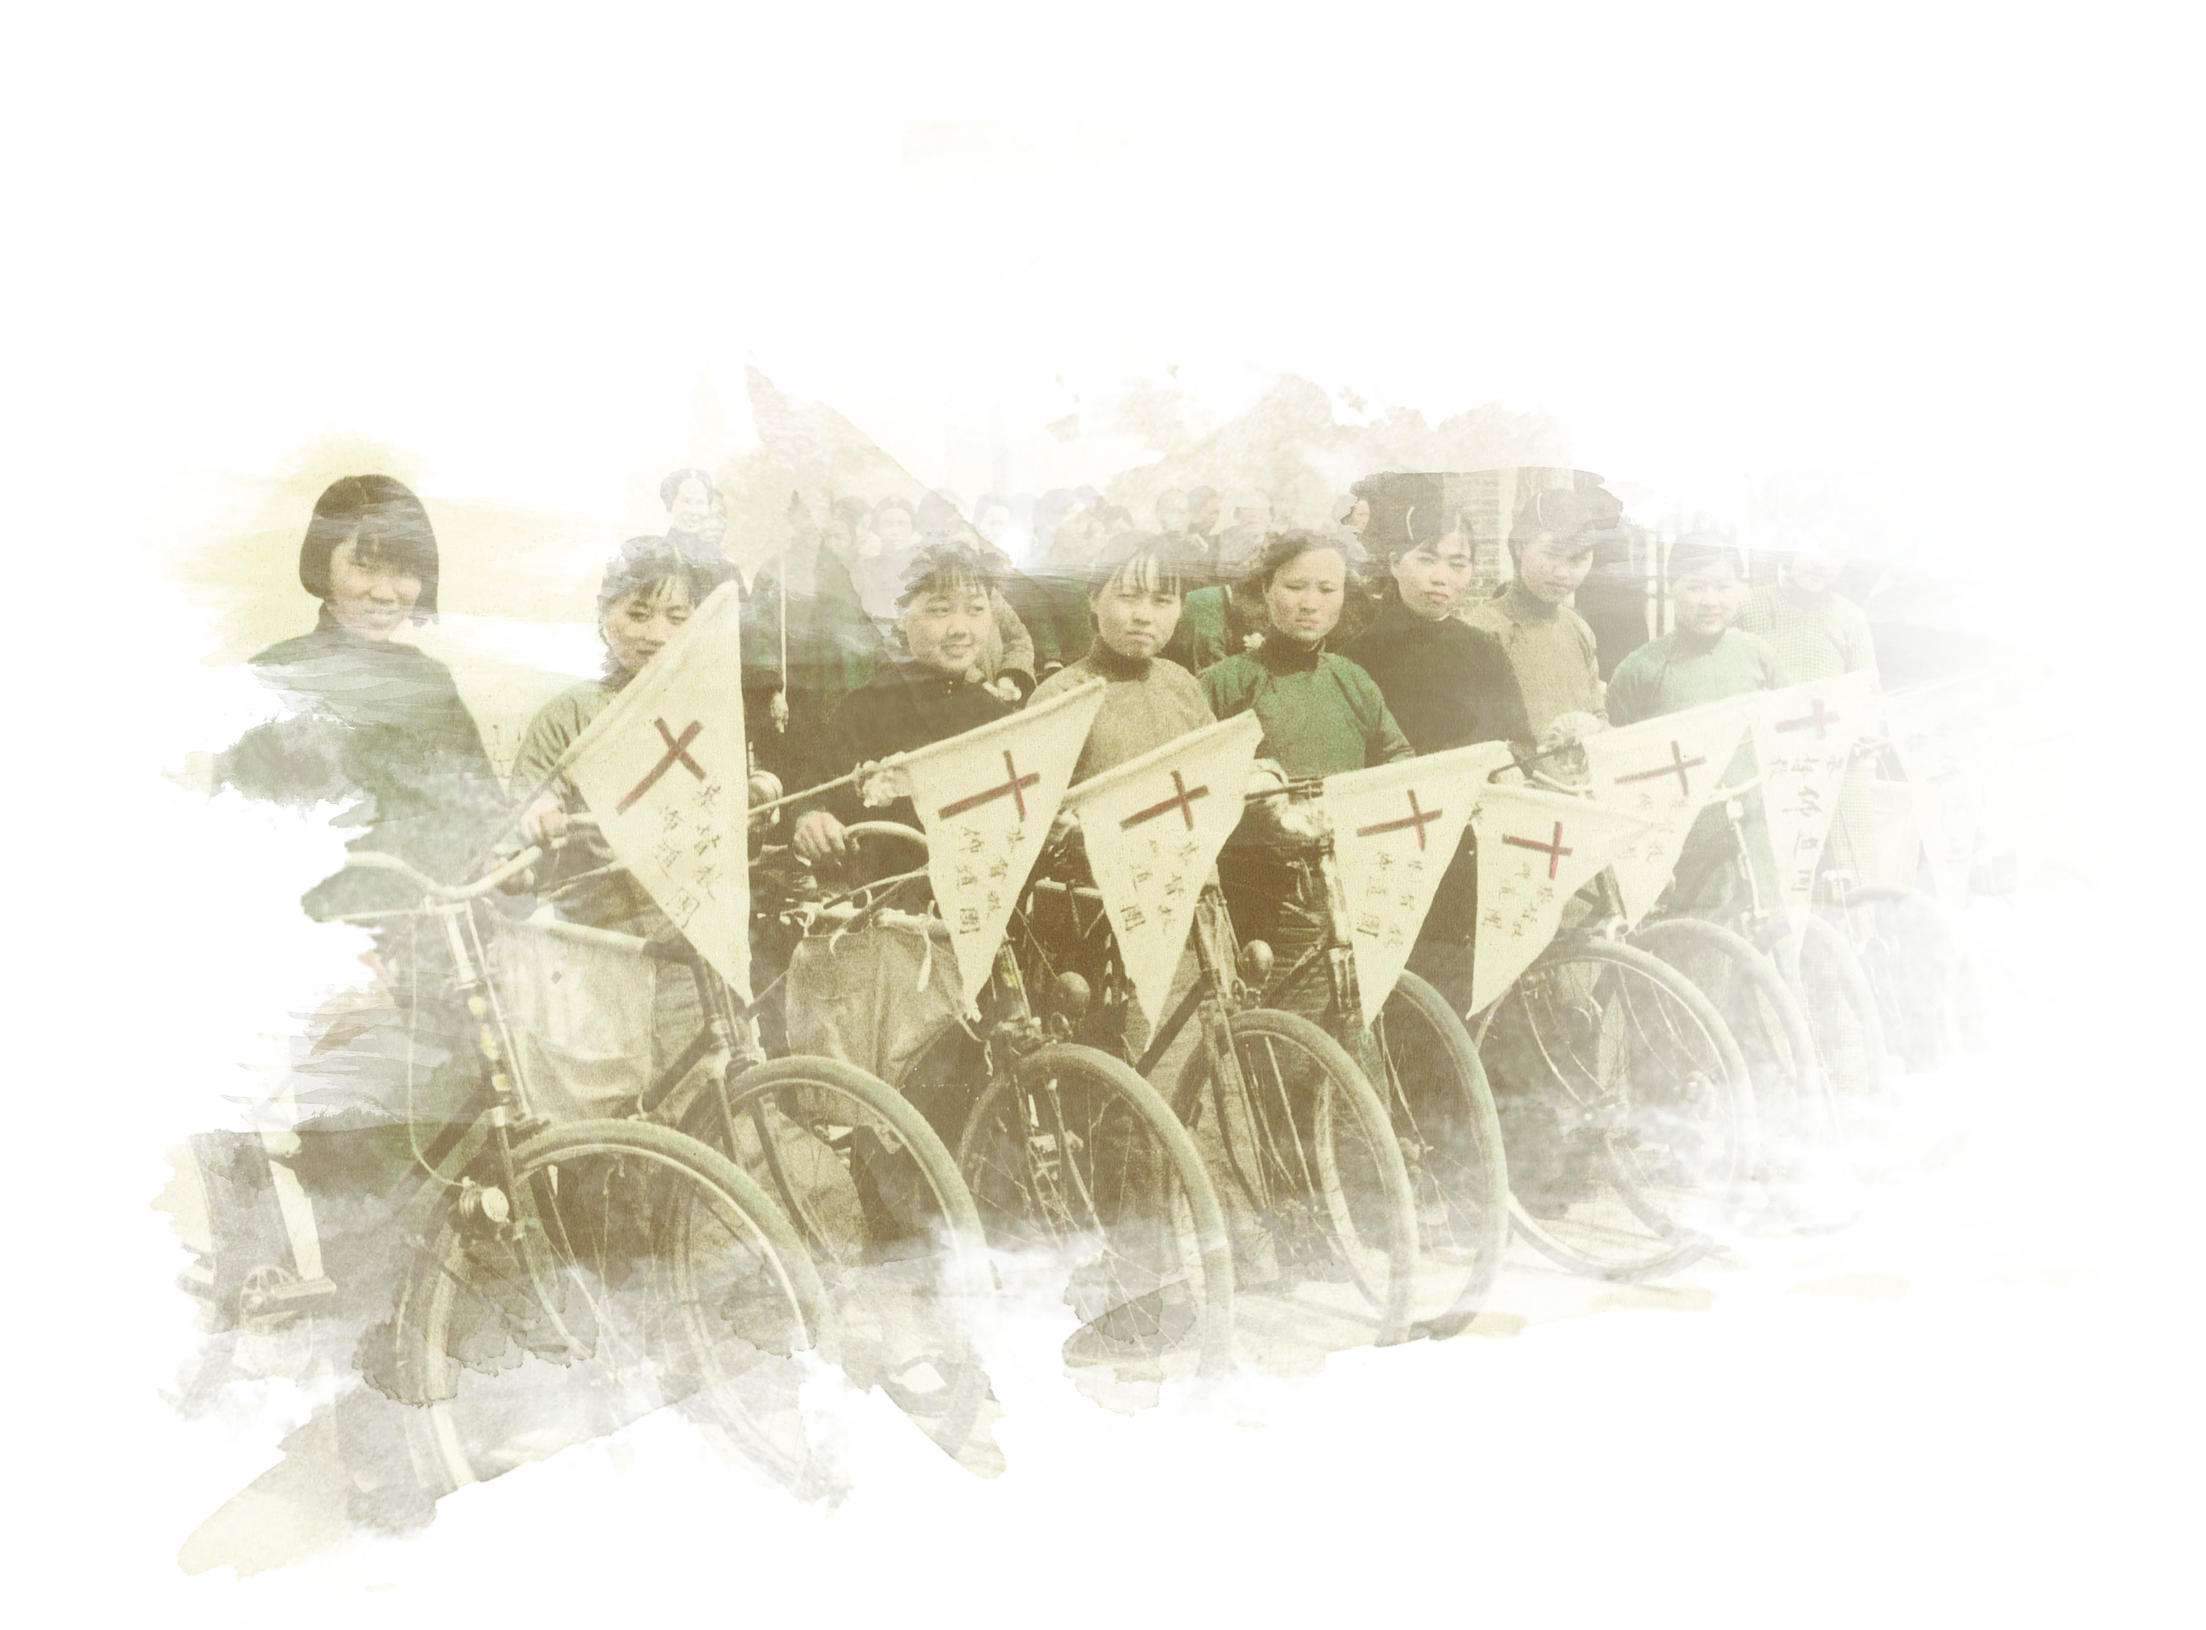
Ecclesiology

Slide 3
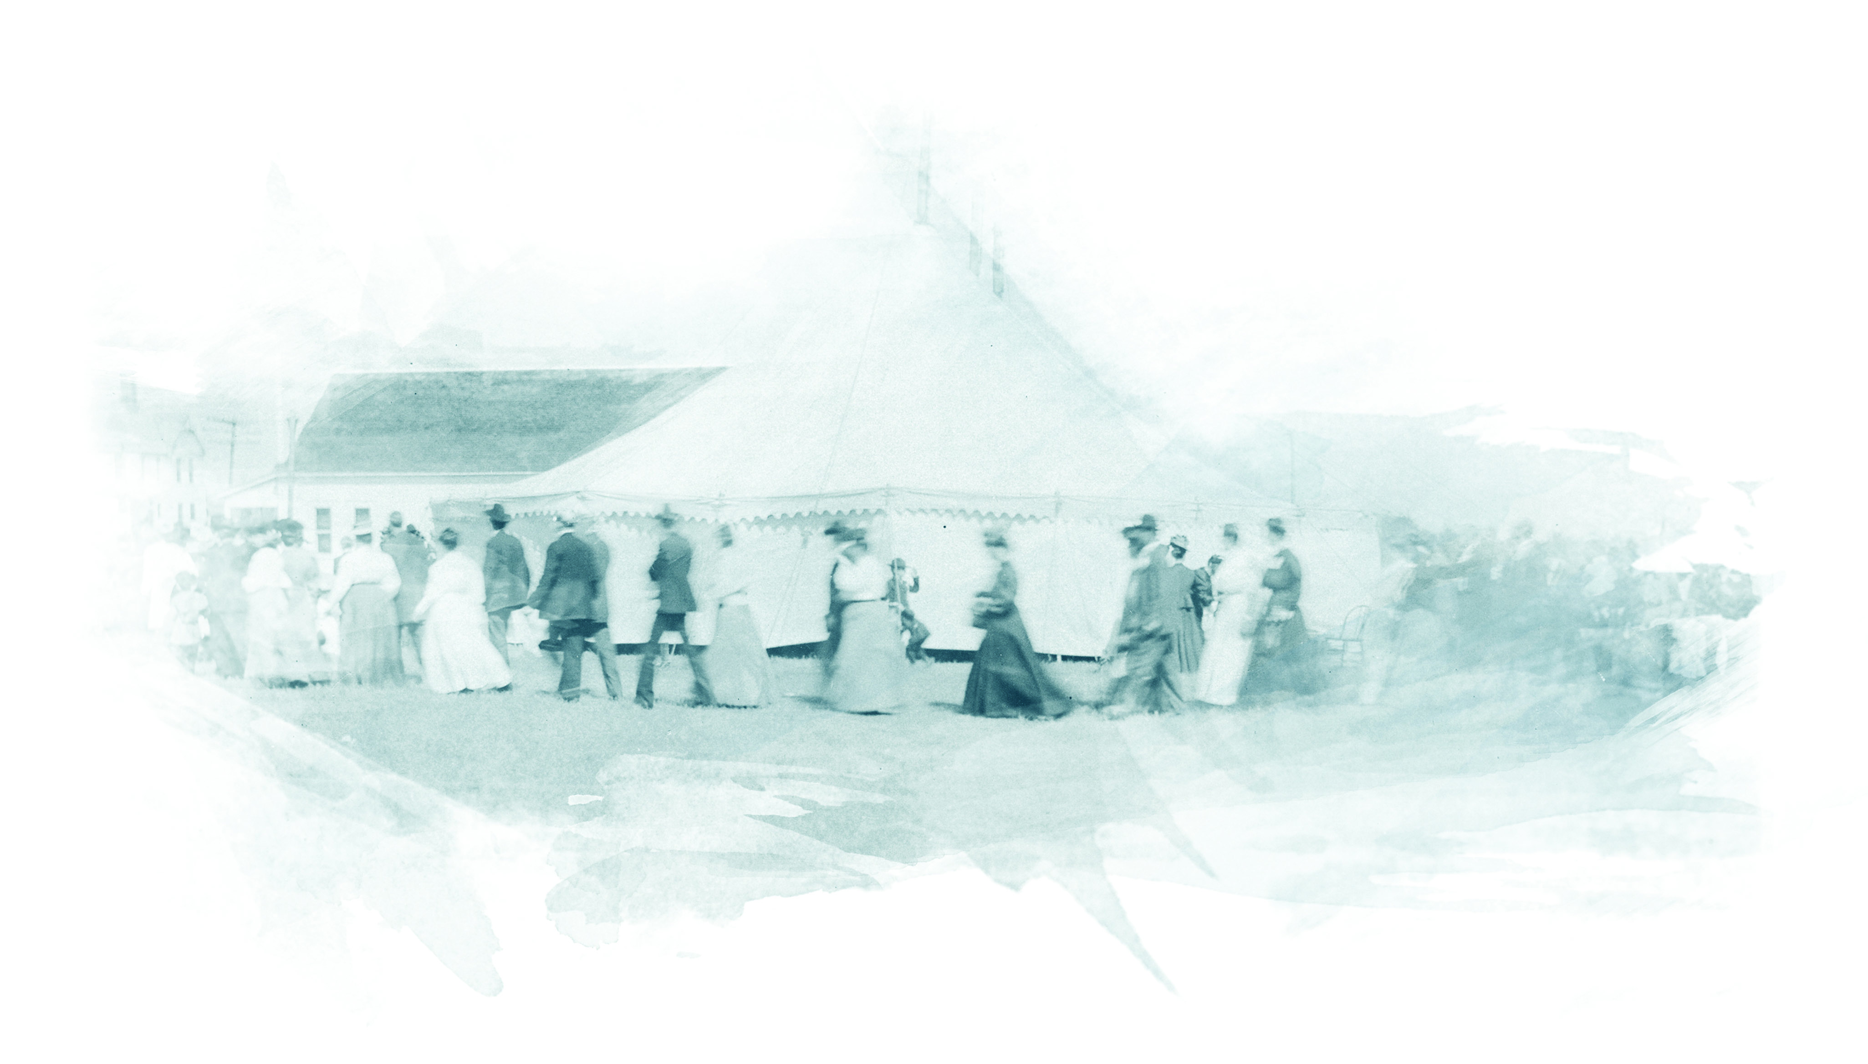
The Early Church

Slide 4
Ephesians 2:19
¹⁹ Consequently, you are no longer foreigners and strangers, but fellow citizens with God’s people and also members of his household…

Slide 5
The Early Church

Slide 6
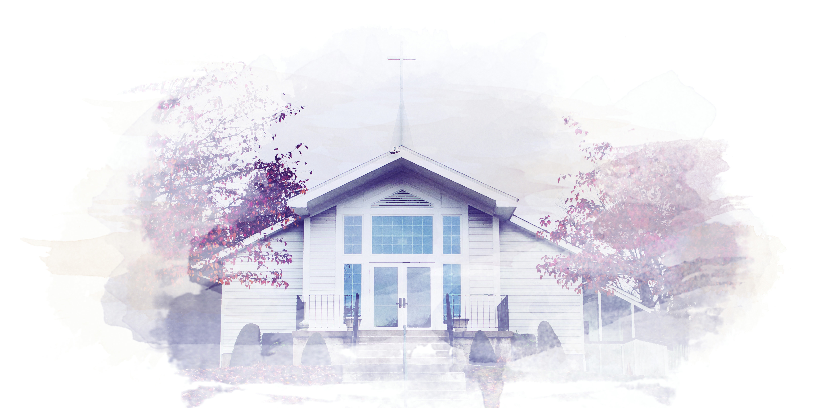
Our Church

Slide 7
John 5:44
⁴⁴ How can you believe when you receive glory from one another and do not seek the glory that comes from the only God?

Slide 8
Our Church

Slide 9
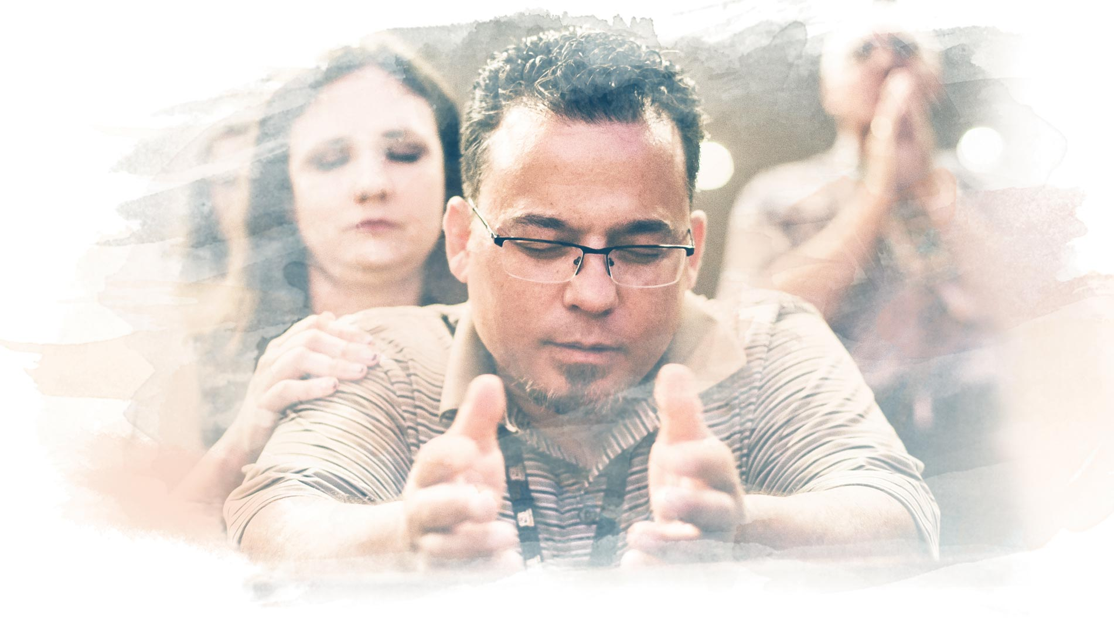
How Do I Ensure I Have Community In My Life?

Slide 10
Isaiah 26:3
³ You will keep in perfect peace all who trust in you, all whose thoughts are fixed on you!

Slide 11
Psalm 133:1
¹ How good and pleasant it is
when God’s people live together in unity!

Slide 12
Ecclesiology

